Slide 1

Decentralized traceability and direct marketing of agricultural supply chain
by
S. Shabana
Roll No. 204G1A0595
N. Sai Charan Reddy
Roll No. 2041A0584
G. Sai Pranav Reddy
Roll No. 204G1A0590
C. Sushmitha
Roll No. 204G1A05A6
Under the guidance of
Mr. M. Narasimhulu M.Tech (Ph.D)
Associate Professor
Department of Computer Science and Engineering
Srinivasa Ramanujan Institute of Technology
(Autonomous)
2023 - 2024

Slide 2

Contents
Review-0 Comments
Abstract
Problem statement
Objectives of Project
Literature survey for first objective
Objective-1(Design & Implementation
Literature survey for second objective
Objective-2 (Design & Implementation)
Proposed Work -(Methods to be followed for proposed system)
References
GitHub Link
Queries

Slide 3
Review-0 Comments
Abstract not clear
Should idea Blockchain
Check and verify proposed system
Objective should idea

Slide 4
Abstract
The agriculture sector is facing the major challenges because of the absence of direct supply chain between farmers and buyers. This will lead to vulnerabilities, reduce the farmers income and compromises product quality. To address these issues, we are developing a web portal which facilitates the visibility of farmers profiles making their details accessible to the wide range of buyers. This approach lets buyers to connect with farmers through the portal, allowing them to negotiate and quickly update price agreements.
To enhance transparency and security, our system incorporates Blockchain technology to record and securely store all transactions. Our innovative web portal strives to bridge the gap between farmers and buyers promoting transparency and trust in agriculture transactions. This approach has the potential to benefit both farmers and consumers while promoting sustainable practices within the agricultural sector.
Keywords: Agriculture supply chain, Direct marketing, Blockchain, Traceability

Slide 5
Problem Statement
Farmers struggle to find reliable buyers for their crops, and buyers face challenges in sourcing quality products at fair prices.
The farmers get less price than the minimum selling price in the market because of many intermediaries present in the current supply chain.
There is no clear and reliable record about the crop, origin, quality, and the final price.
There is no direct communication and negotiation between the farmer and the buyer.
Lack of transparency in transactions makes it difficult for the farmer and the buyer to trust each other leading to disputes.

Slide 6
Objectives of Project
To design a web portal that facilitates farmers to sell their products in a direct and transparent manner.
To bridge the gap between farmers and buyers, promoting transparency, traceability, and trust in agricultural transactions by providing a digital platform for them to connect which helps farmers to get better pricing for their crops.

Slide 7
Literature survey for first objective
S.NO | YEAR | AUTHORS | TITLE | OUT COMES
1 | International journal, 2018 | Shivendra, Chiranjeevi, Tipathi, M.K & Maktedar | Agricultural marketing and Agri-Business in India | It utilizes blockchain to streamline supply chain operations, reduce fraud, and ensure the authenticity of agricultural products, ultimately benefiting farmers and consumers while fostering trust in the industry.
2 | Journal,April 2016 | K. Salah N. Nizamuddin R. Jayaraman and M. Omar | e-National Agriculture Market - approaches for generating awareness | It provides a transparent and tamper-proof system for tracking soybean products, ensuring authenticity, reducing fraud, and ultimately improving supply chain efficiency and consumer trust.

Slide 8
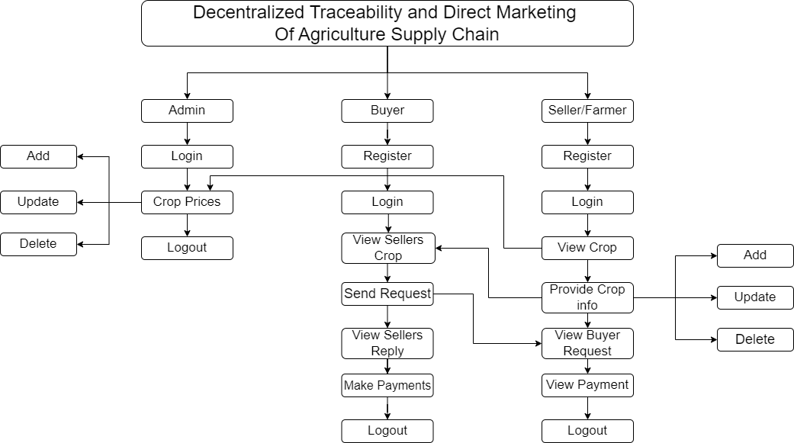
Project Workflow
Fig 1. Data flow Diagram

Slide 9
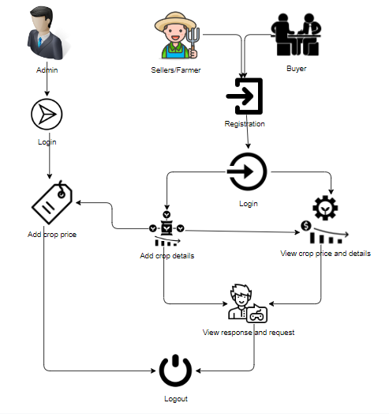
Architecture
Fig 2. Architecture

Slide 10
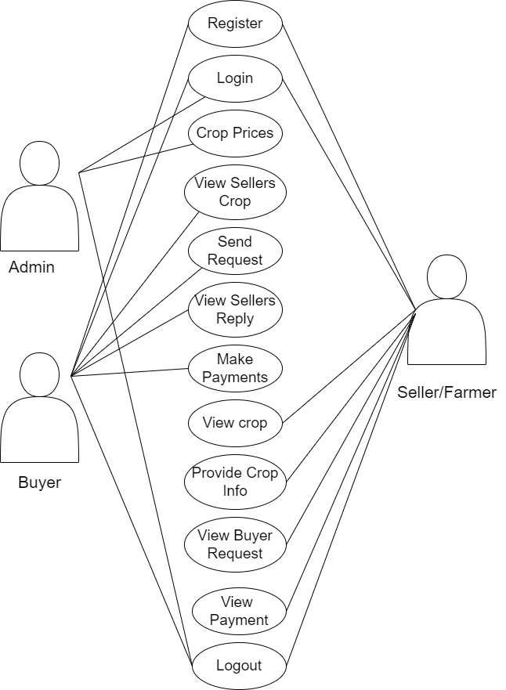
Design and implementation of first objective
Fig 3. Design of first objective(use case diagram)

Slide 11
Modules
To develop a decentralized traceability for agriculture supply chains, break down the functionality into several modules for the different user roles: Buyer, Seller, and Admin. Here are the modules for each role:
Buyer:
Register: The buyer will register with their details like name, email, password, address, contact, so after that the buyer will login.
Login: After registration the buyer will login with their details.
View seller’s crop info: Once the sellers will add the details the buyer can view those details here.
Send Request to Seller: If the buyer wants the details of crop then buyer will send request to seller.
View Seller Requests: Displays responses from sellers to the buyer's requests.

Slide 12
Modules
Make Payment: Once the seller accept the request for the crop the buyer has to pay the amount for that crop.
Logout: Allows buyers to logout securely.
Seller:
Register: The seller will register with their details like name, email, password, address, contact, so after that the seller will login.
Login: After registration the seller will login with their details.
Provide Crop Information: The seller will add there crop details like (crop name, crop category, and quantity and quality).
View Buyer Requests: When the buyer will send the request for the crop, here the buyer will view and he/she has to accept the request.

Slide 13
Modules
View Payments: Once the buyer will pay the amount for the crops. The seller can view the details of the payment.
Logout: Allows sellers to logout securely.
Admin:
Login: The admin will login with default email and password.
Crop price: The admin is the person he/ she will add the crop price for each and every crop details with that crop name, category, minimum cost and quantity.
Logout: Allows the admin to log out securely.

Slide 14
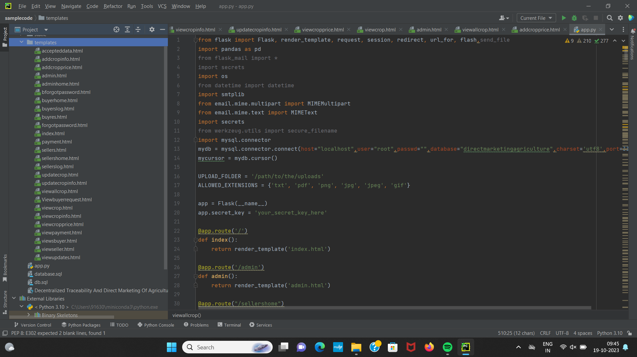
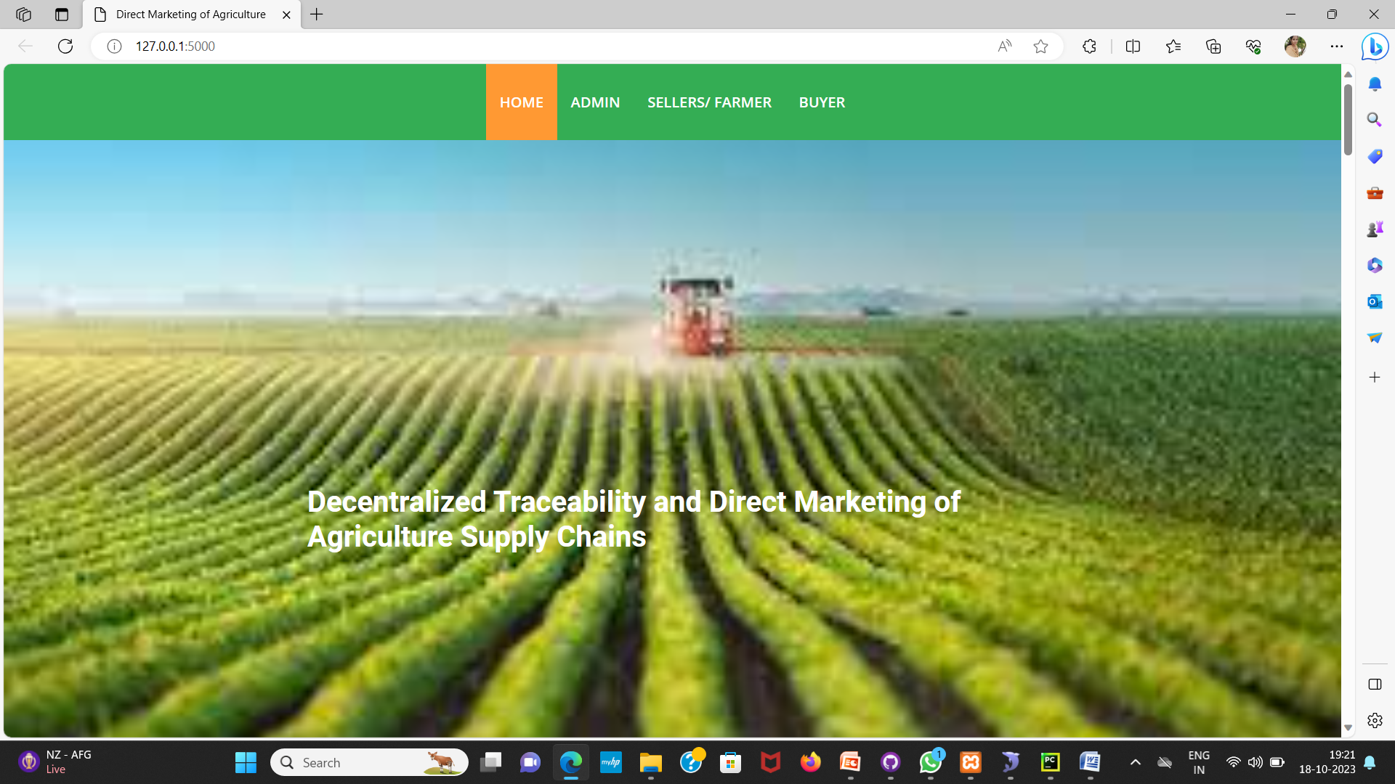
Design and implementation of first objective
Fig 4. Code and Ouput of the home page

Slide 15
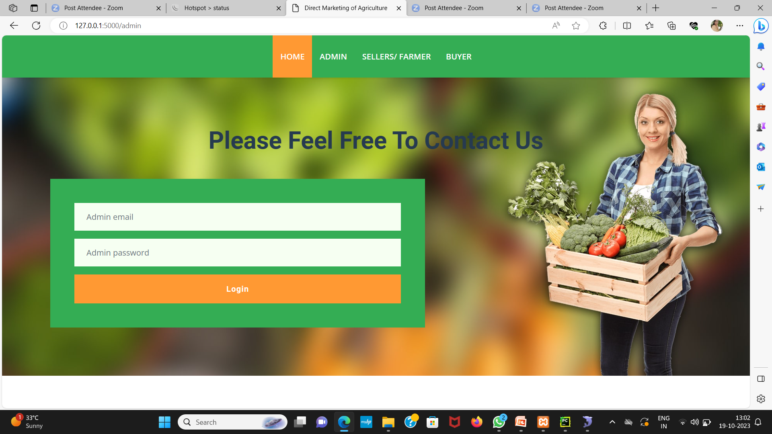
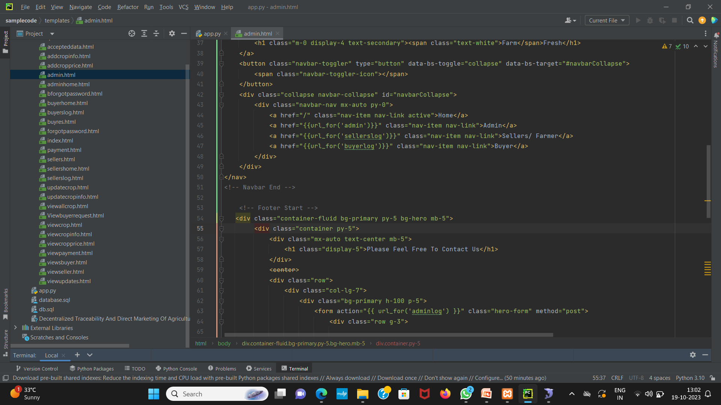
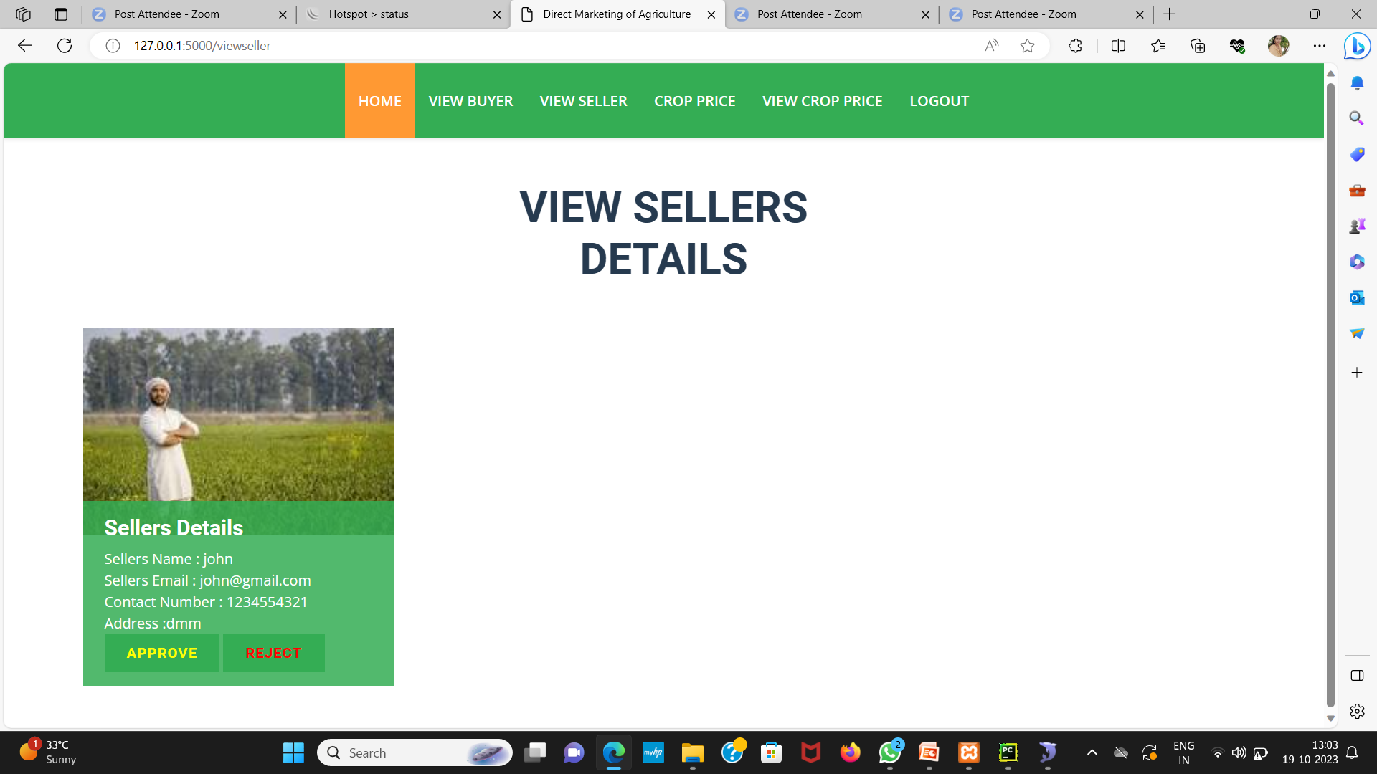
Design and implementation of first objective
Fig 5. Admin’s login page

Slide 16
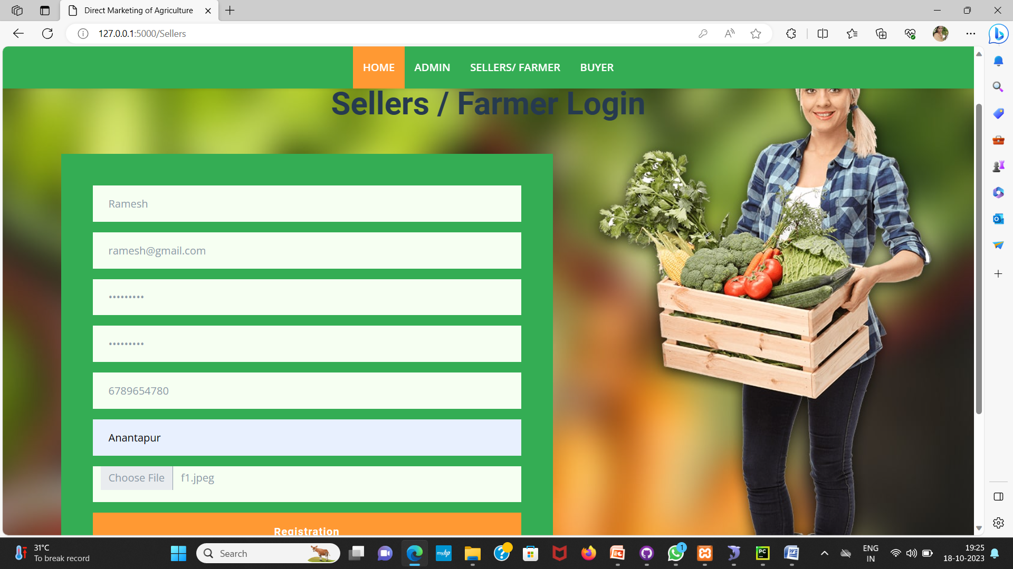
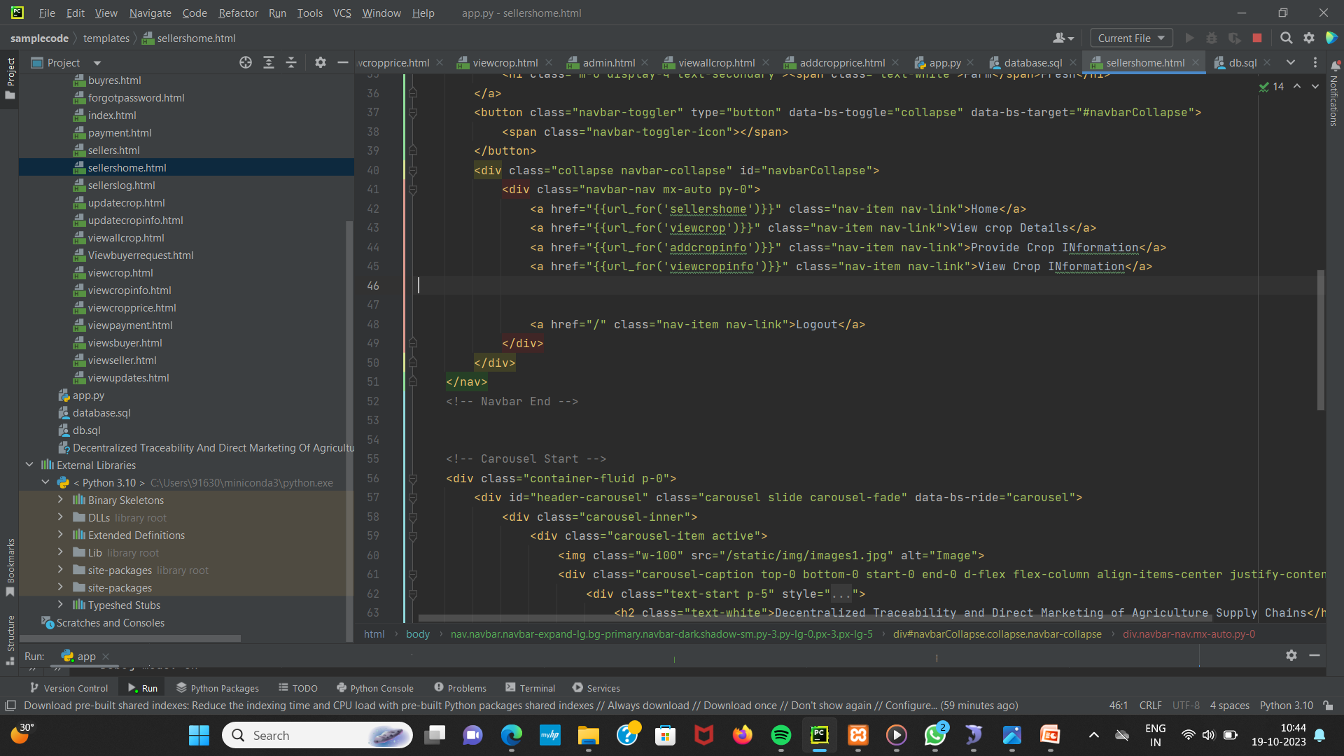
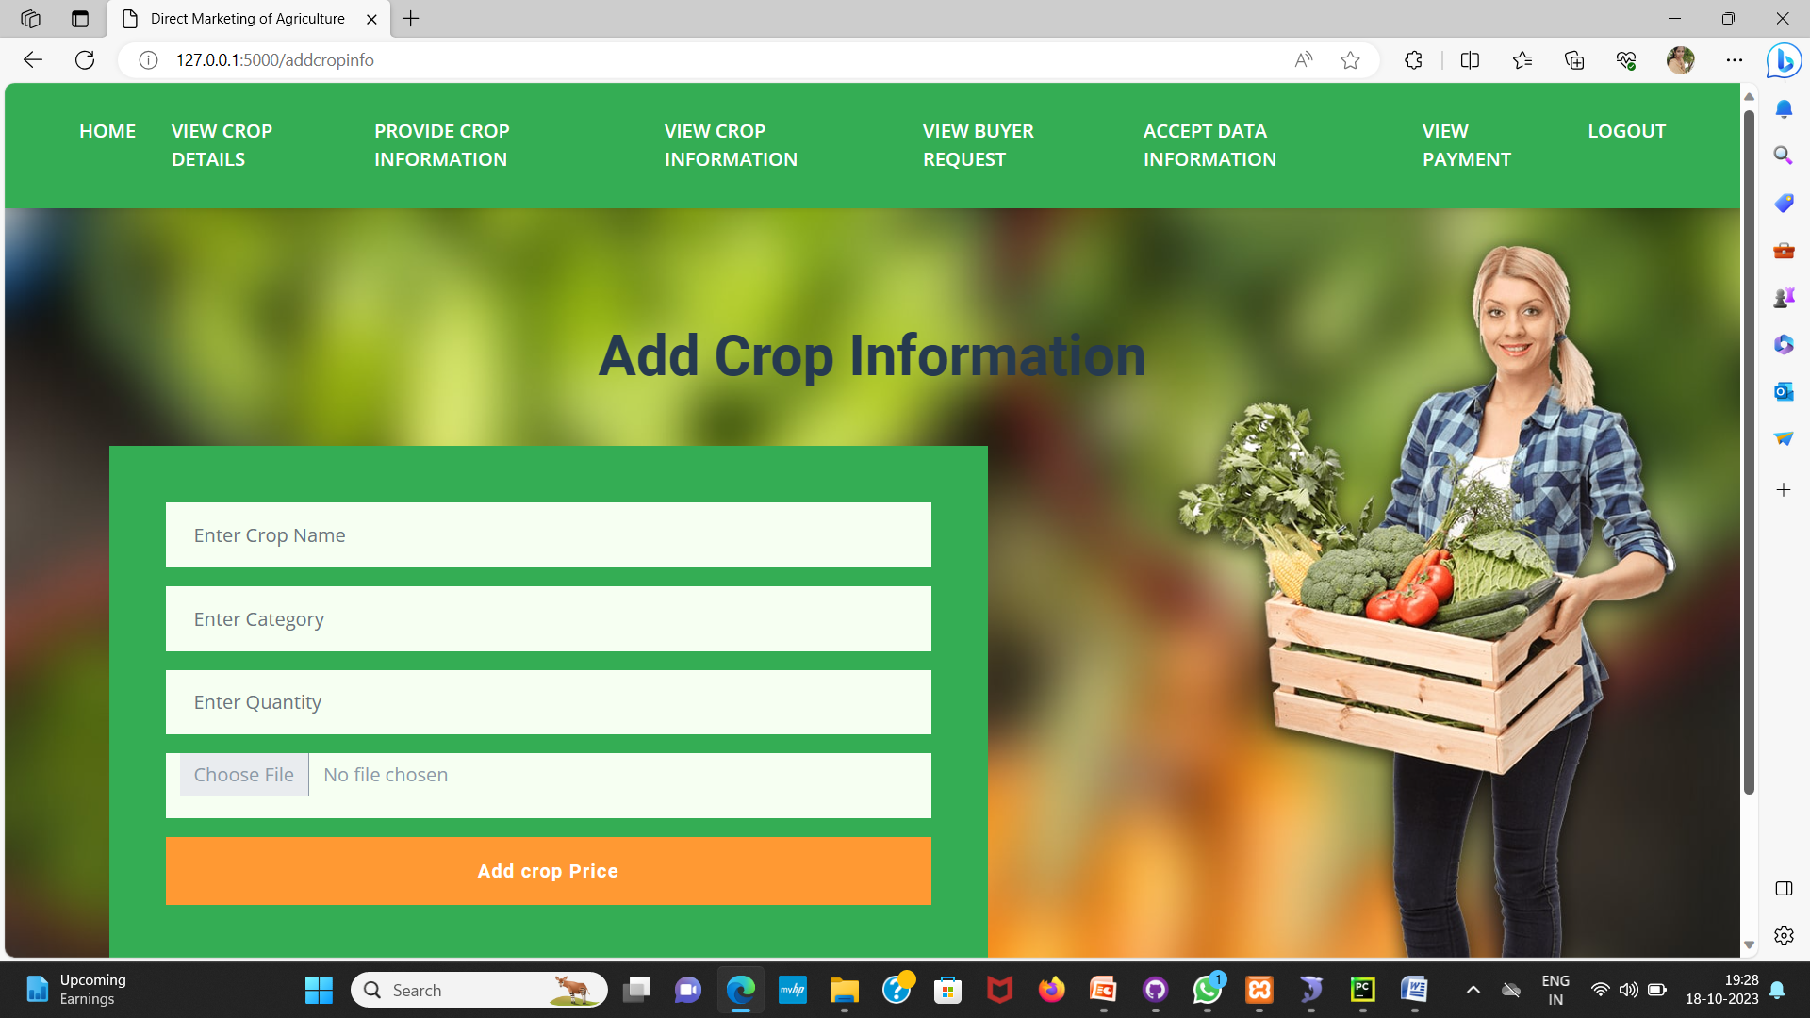
Design and implementation of first objective
Fig 4 . Output pages of the seller registration and login details

Slide 17
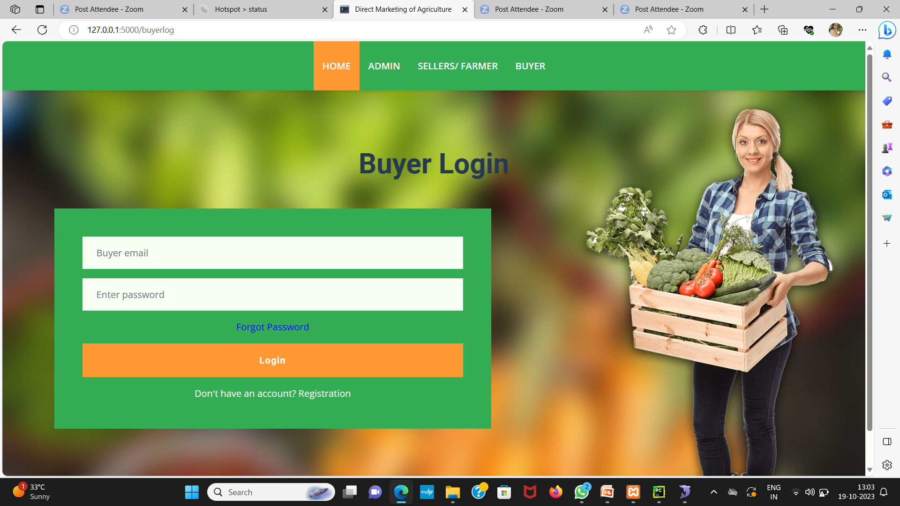
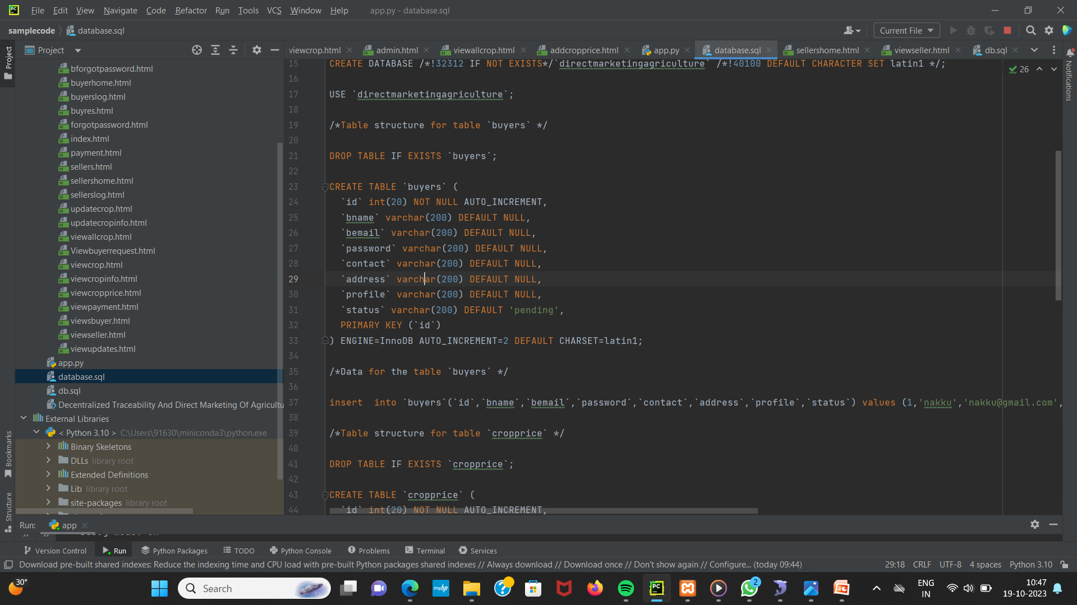
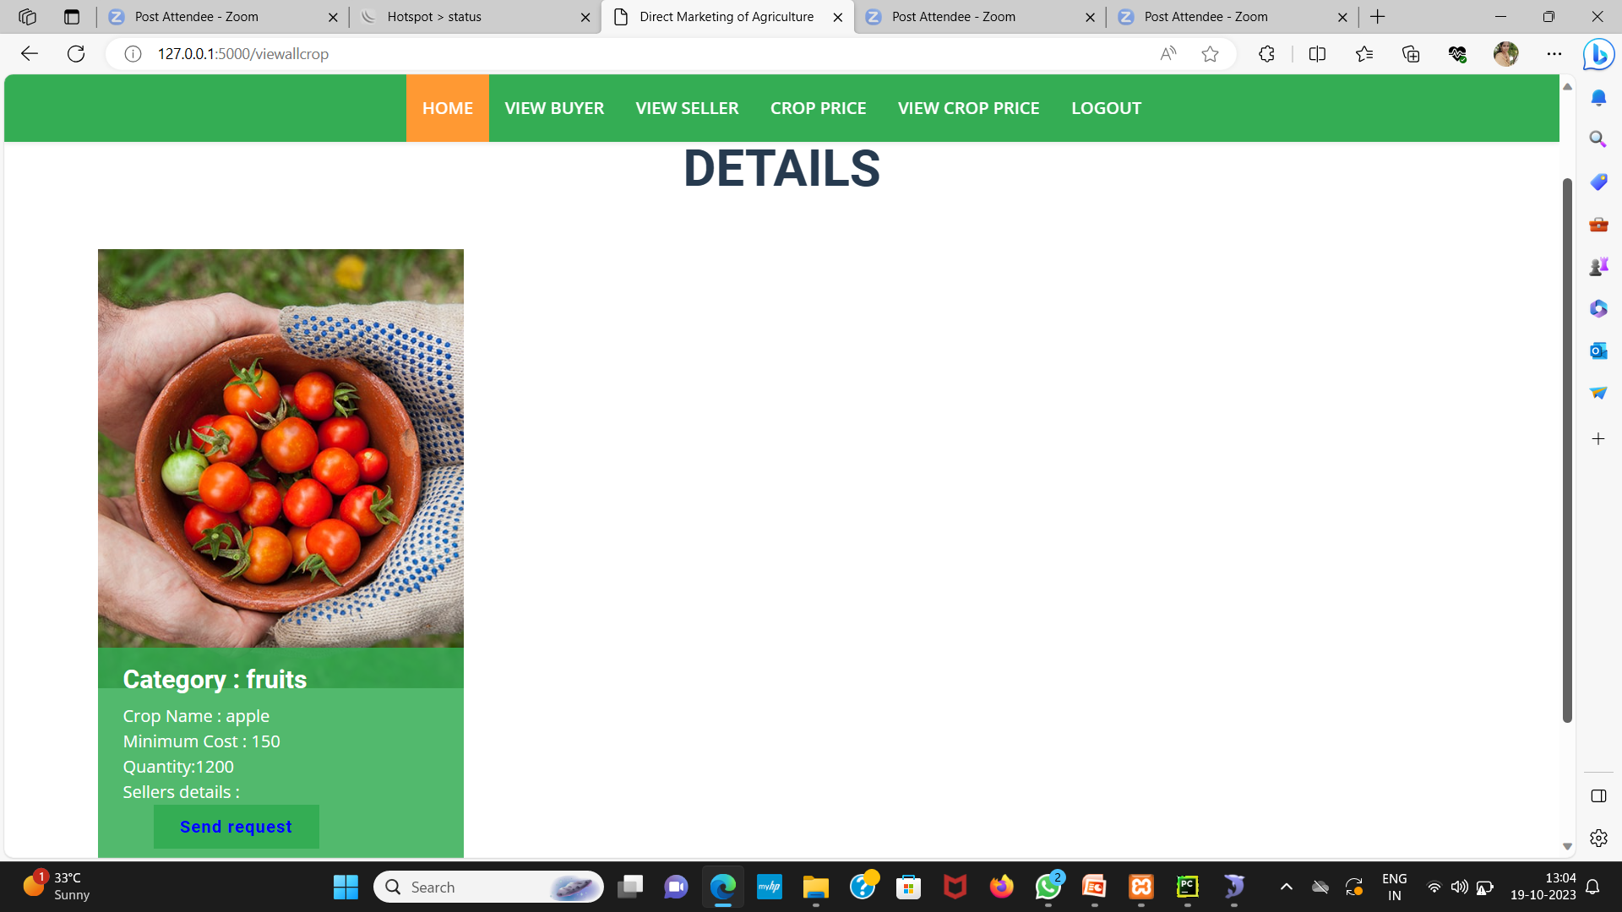
Design and implementation of first objective
Fig 5. Buyer registration and login details

Slide 18
Literature survey for second objective
Farmers lack of awareness about market prices affects their ability to negotiate effectively with intermediaries and buyers, often leading to lower income for their produce. [3][4]
Blockchain’s transparent and immutable nature can enable farmers to have transparent visibility into transaction history, ensuring fair pricing and reducing the risk of fraud. The agricultural blockchain solution can reshape farmer-consumer-intermediary dynamics, transforming the industry. The interface is developed for buyers to access the farmer’s details and process transactions and vice versa.[2]

Slide 19
Proposed System
The proposed system aims to establish a decentralized traceability and direct marketing platform for agricultural supply chains.
Buyers can easily access the system through registration and login, enabling them to view seller crops, send requests, and make payments seamlessly.
Sellers, after registering and logging in, can provide crop information, view buyer requests, and track payments received. Additionally, the system empowers the admin to log in, manage fixed payments, and ensure smooth operations.
This platform incorporates Blockchain technology that enhances transparency, efficiency, and trust within the agriculture supply chain, promoting fair and direct interactions among stakeholders.

Slide 20
References
[1] Shivendra, Chiranjeevi, Tipathi, M.K & Maktedar, “Blockchain Technology in Agriculture Product Supply Chain”.
[2] K. Salah N. Nizamuddin R. Jayaraman and M. Omar, "Blockchain-based soyabean traceability in agricultural supply chain" IEEE Access vol. 7 pp. 73295-73305 2019.
[3] “Agricultural marketing and Agri-Business in India”
[4] “e-National Agriculture Market - approaches for generating awareness”

Slide 21
Git Hub Dashboards of each student

Slide 22
Any Queries?

